Slide 1
Arlo Belshee
Agile Suitcase

Slide 2
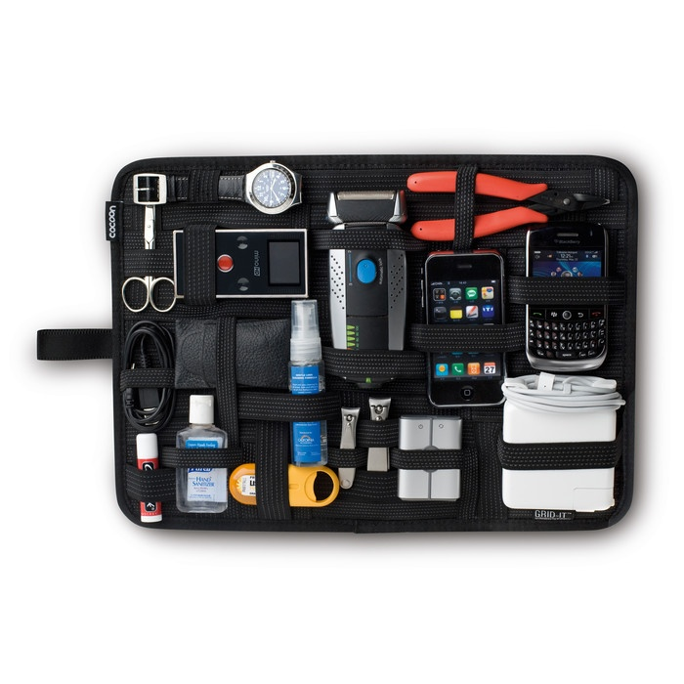
The typical agile suitcase
Complaint-fest retrospectives
Stories
Adaptive planning
Visible upcoming work
Stand-ups
Visible status
Estimation

Slide 3
My agile suitcase
Stuff I need
Stuff others need but always leave at home

Slide 4
My agile suitcase
Code well:
Work Tiny. Prove it. Get Done.
Learn and improve discipline.
Make changes together.
Plan,
Status,
Stories,
Burn-up,
Stand-up
Work together. Win together.

Slide 5

Work tiny

Slide 6
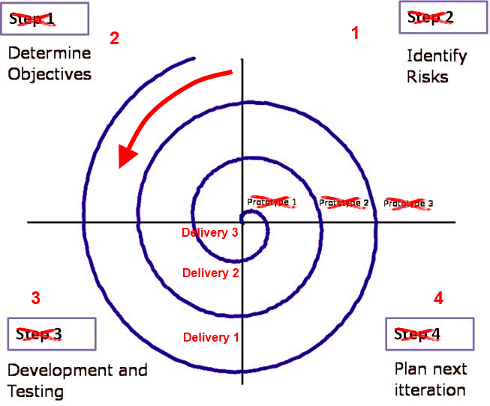
Work tiny – spiral in reverse

Slide 7



Work tiny – impressive results eventually
Ship live
Check in
Validate business impact
Notes:
I check code in every 90 seconds
Flikr ships to production every 6 min
Yammer proves effect of idea on user behavior in < 1 day
Retention takes 1 week

Slide 8
Prove it
Traditional or 1 star Agile
2+ star Agile
Dev’s job
deliver software
Write ~8 bugs / man-day
Dev’s job
Deliver software
Demonstrate software does what devs expect
Tools
Mechanized refactoring
Small steps, with reverting
Test first
Automated developer testing
Design in units
Design for testability
Write ~1 bug / 80 man-days

Slide 9
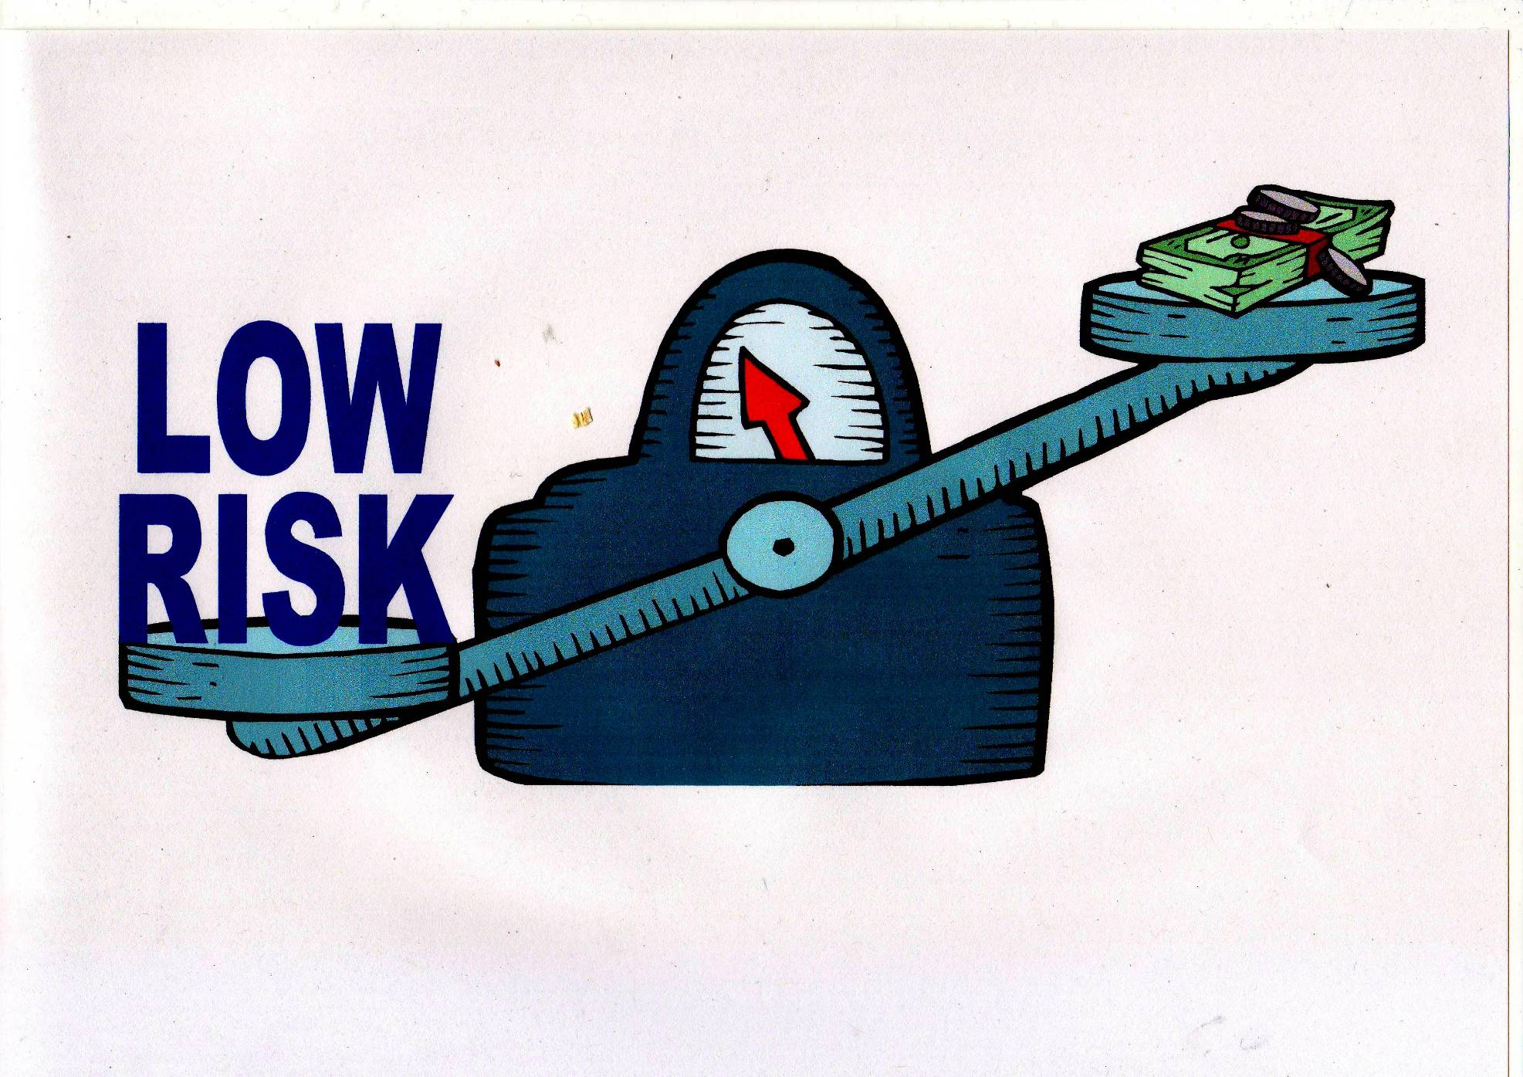
No bugs!
Notes:
Making changes does not introduce bugs. Low risk = low transaction cost.

Slide 10
Low cost changes => Emergent Design
Pain
No Pain
You aren’t gonna need it
“Hey, we could …”
The simplest thing that could possibly work

Slide 11
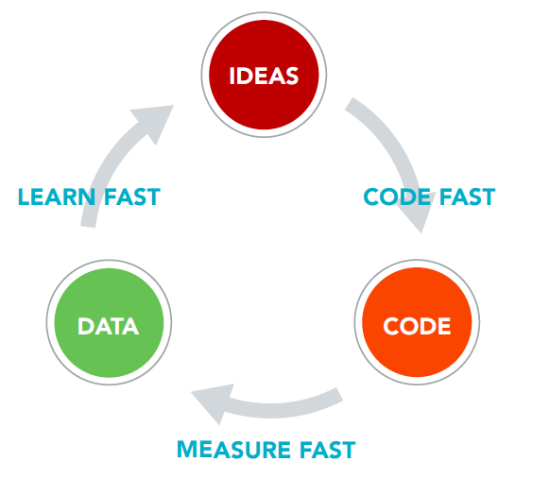
Low risk changes => Learn in the market

Slide 12

Get done
April
May
June
July
Product A
Product B
Product C
Revenue:
A+B+C
VS
April
May
June
July
Product A
Product B
Product C
Revenue:
A
A+B
A+B+C

Slide 13
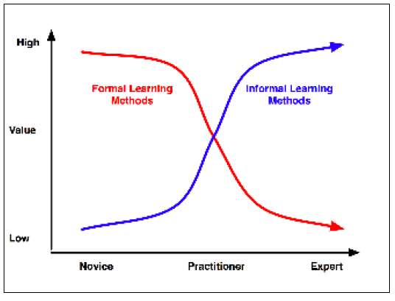
Learn informally

Slide 14

Learn constantly

Slide 15
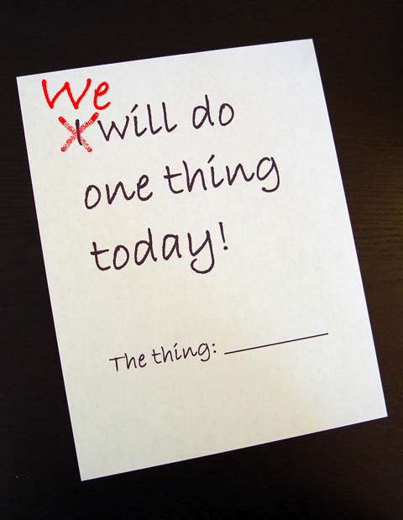
Improve together

Slide 16
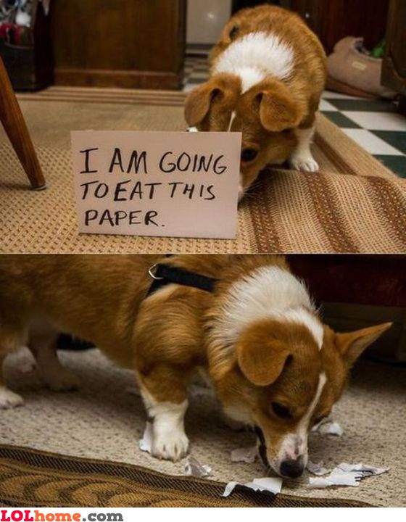
Be trustworthy – be predictable

Slide 17

Be trustworthy – consider others

Slide 18
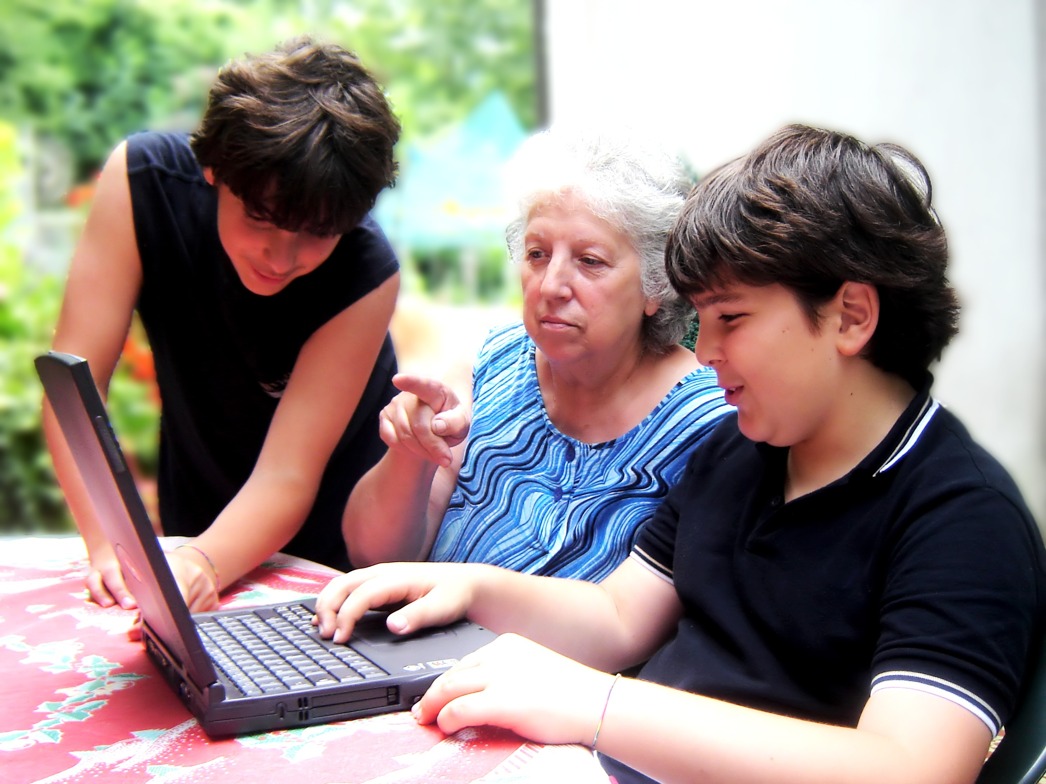
Do the work together
Notes:
It should be impossible to tell who to reward for any one success. It should be impossible to tell who to punish for any one failure.

Slide 19
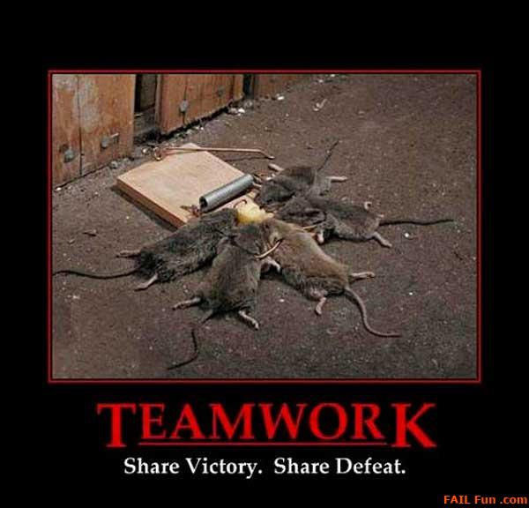

Slide 20
My packing list generator
Work tiny
Prove it
Get done
Learn constantly
Improve together
Be trustworthy
Win together

Slide 21
My current packing list
Pair or mob, 100%
Design small units
100% mechanized refactoring
Tests are specs; write them first
Finish and prove each step before starting the next
1 process change / week (minimum)
Decentralize all decisions
Involve people directly

